Slide 1
Movie Recommender System
Somil Bhargava

Slide 2
Motivations for Building a Movie Recommender System
Generate movie recommendations for the general public
Direct consumer awareness and spending towards products they would appreciate or enjoy
Outside the context of movie recommendations, such a system has a high potential impact across a variety of industries
Recommend products in online retail
Recommend entertainment (movies, TV, books, video games)
Recommend travel destinations

Slide 3
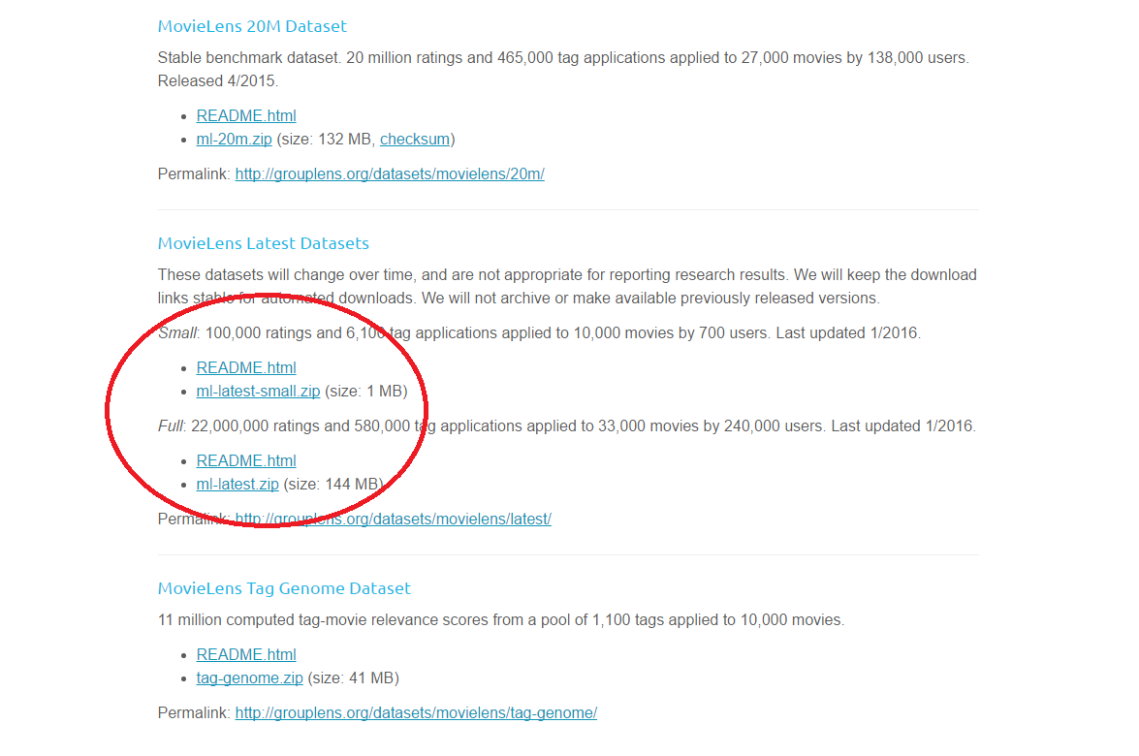
The Data can be found at: http://grouplens.org/datasets/movielens/

Slide 4
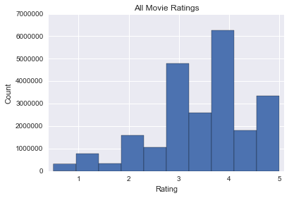
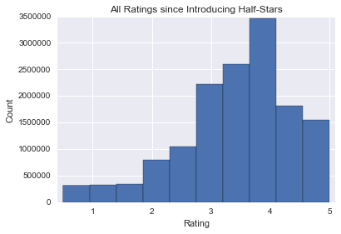
The odd distribution is due to a late implementation of half-star ratings.
Half-star ratings were introduced in February 2003
The data collection started in 1995
The recommendation system will require a filter to correct the distribution

Slide 5
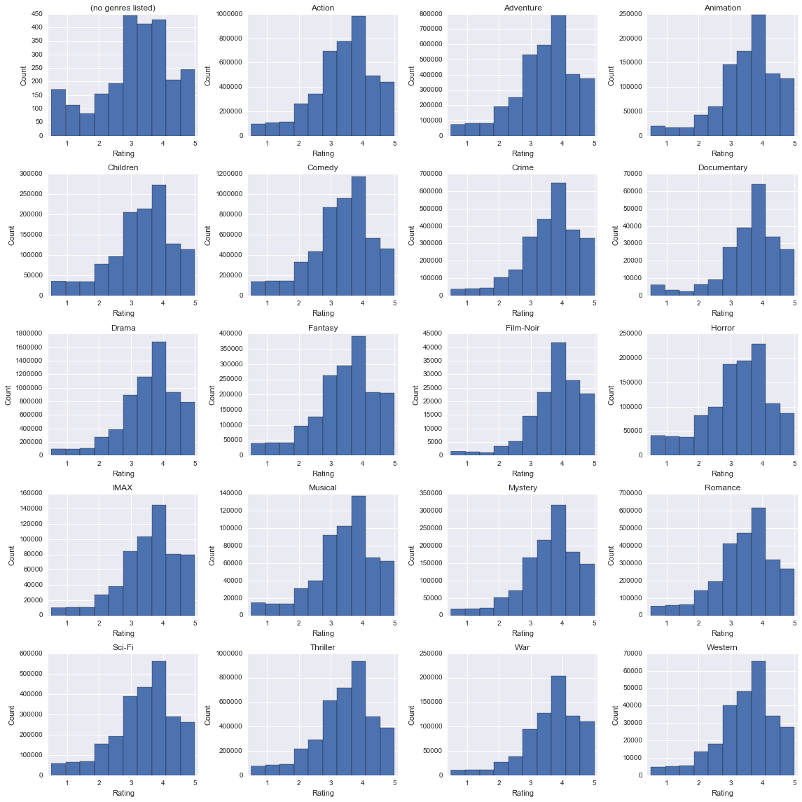
The left-skewed rating distribution persists regardless of movie genre.
'(no genres listed)' | 'Action' | 'Adventure' | 'Animation'
'Children' | 'Comedy' | 'Crime' | 'Documentary'
'Drama' | 'Fantasy' | 'Film-Noir' | 'Horror'
'IMAX' | 'Musical' | 'Mystery' | 'Romance'
'Sci-Fi' | 'Thriller' | 'War' | 'Western'
(no genres listed) and IMAX aren’t truly genres because they don’t have anything to do with the story

Slide 6
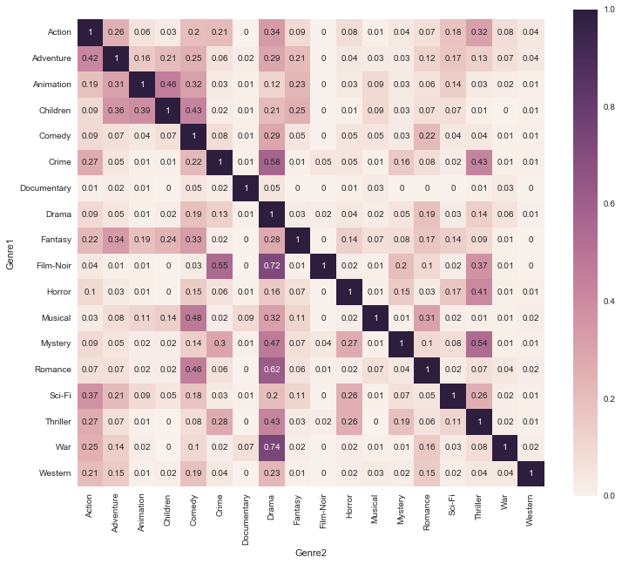
Genre overlap could be used to complement movie recommendations.
X% of movies in Genre1 also belong to Genre2
Some genres have a large overlap with others and may contain similar themes
May be useful for refining recommendations
Documentaries have almost no overlap because they are geared towards education rather than entertainment

Slide 7
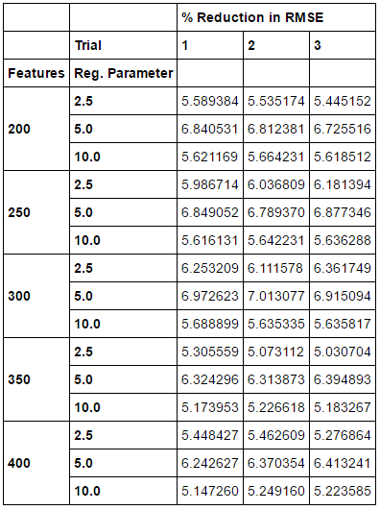
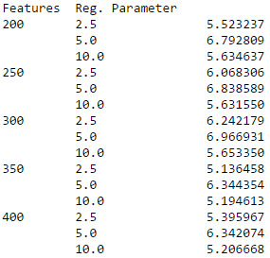

Optimized model reduces RMSE by 7.41% in comparison to predicting the movie’s average rating
Optimization Results
% Reduction in RMSE
on testing partition
Average % Reduction in
RMSE on testing partition

Slide 8
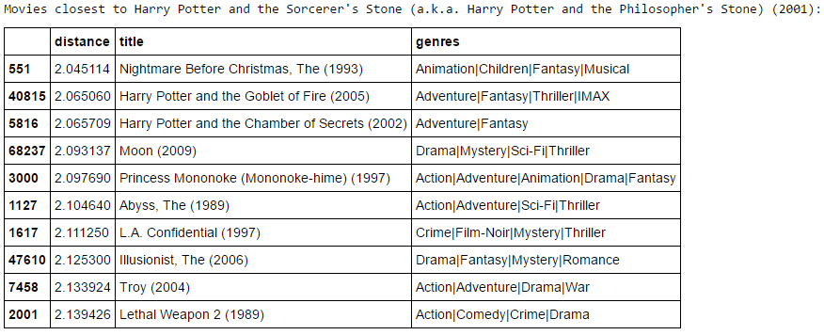
The system can now produce a list of recommended movies similar to a target movie.

Slide 9
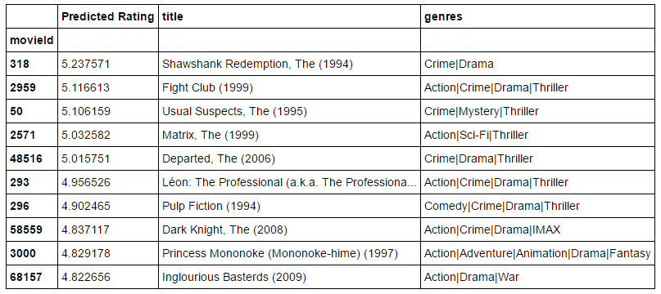
Or, it can recommend movies based on ratings a user has supplied.

Slide 10
There is still space for improvement.
Computational and time constraints limited the dataset I could build the model from
The list of similar movies can be improved by rewarding ‘genre similarity’ to reduce the occurrence of questionable movie similarities
Example: “L.A. Confidential” doesn’t seem very similar to “Harry Potter and the Philosopher’s Stone”

